Slide 1
App Service Web Apps

Slide 2
Agenda
App Services
Why App Services
Web App
Web Job
API App
Logic App
Mobile App

Slide 3
Visual Studio 2015 Offerings
Visual Studio 2013
PROFESSIONAL WITH MSDN
PREMIUM WITH MSDN
ULTIMATE WITH MSDN
MSDN PLATFORMS
TEST PROFESSIONAL WITH MSDN
Visual Studio 2015
PROFESSIONAL WITH MSDN
ENTERPRISE WITH MSDN
MSDN PLATFORMS
TEST PROFESSIONAL WITH MSDN
Notes:
This year, we collapsed the Visual Studio Premium and Ultimate products into Visual Studio Enterprise. If you have always wanted to be able to use one of the cool features in Ultimate, hopefully now you can. And, if you’ve always had Ultimate, not it’s just a lot cheaper!

Slide 4
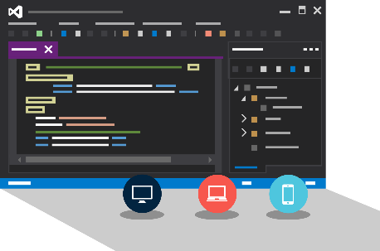
Visual Studio + App Service Web Apps
IntelliTest
IntelliTrace
Performance & Diagnostics
Azure Explorer
Notes:
Leverage VS Enterprise to increase developer productivity with IntelliTest, IntelliTrace, Performance & Diagnostics, and Azure Explorer.

Slide 5
Azure App Service

Slide 6




Azure App Service
Powerful Web and Mobile Cloud Apps
Web Apps
Logic Apps
Mobile Apps
Customer Site
Order Processing
Customer App
API Apps
http
SQL
Notes:
App Service allows you to create the following app types from a single development experience:
Web Apps - Quickly create and deploy mission critical Web apps that scale with your business.
Mobile Apps - Engage employees, partners and customers on any device at any time.
API Apps - Easily build and consume Cloud APIs.
Logic Apps - Automate the access and use of data across clouds without writing code.
As a single integrated service, App Service makes its easy to compose the above app types into a single solution, allowing you to easily build apps that target both web and mobile clients using the same back-end and integrate with on-premise systems as well as popular services such as Office 365 and salesforce.com.

Slide 7
Benefits
Integrated Enterprise Capabilities
Security
High Availability
Backup & Restores
Load Balancing
Automated scale out/in
SaaS Managed Platform
Focus on Application Services not Platform
Managed OS & Platform Patching
.NET, Node.js, Python, Ruby and many more
Easy Continuous Deployment
Visual Studio Team Services
Kudo
Roll-Back & In-Production Testing

Slide 8
App Service Environment (ASE)
Premium Tier Feature
Dedicated compute resources and network resources
Increased Scaling Options
Directly created in a Virtual Network
Support all Web App features and capabilities
Support Web, Mobile and API Apps
Global Scale
Notes:
App Service Environments are a Premium service feature that provided a fully isolated and dedicated environment for securely running App Services at high scale.
Why:
Need for high scale Request Per Second workloads
Isolation – No other customers apps run in the environment
Network Traffic Control

Slide 9
Web Apps

Slide 10
Full capability set available including:
.NET, Node.js, Java, PHP, and Python
WebJobs for long running tasks
Integrated VS publish, remote debug…
CI with GitHub, BitBucket, VSO
Auto-load balance, Autoscale, Geo DR
Virtual networking and hybrid connections
Site slots for staged deployments
Web Apps
Web apps run as-is
no changes required

Slide 11
App Service Web App Architecture
Deployment
Server(s)
File Server
Publish Endpoint
Blob Storage
Application Database
Frontend (IIS ARR)
Microsoft Azure
Load Balancer
Metering
Runtime Database
API Endpoint

Slide 12
Demo: Creating a Web App

Slide 13
WebJobs

Slide 14








Light-weight CPU Intensive Tasks
run.cmd, run.bat
run.exe
run.ps1
run.sh
run.php
run.py
run.js
Job Type:
On-Demand, Scheduled, Continuous
Scale:
Singleton, Multi-instance
WebJobs SDK Feature:
BlobTrigger, TableTrigger, QueueTrigger, ServicebusTrigger
Deployment:
Portal, Visual Studio, CLI, Git

Slide 15
Demo: WebJobs

Slide 16
API Apps

Slide 17
Easily use cloud or custom APIs:
Dozens of built-in APIs for popular SaaS
An ecosystem of APIs for any need
Create and publish custom, reusable APIs
Visual Studio tooling with one click publish and remote debugging
Automatic client SDK generation for many languages
Api Apps
Create, consume and
host APIs more easily

Slide 18
Benefits of API Apps
Bring your API as-is
.NET Web API
Node.js + Express
Java
PHP
Many other technologies
Connect easily to SaaS platforms

Slide 19
API Apps addresses key pains around building and consuming APIs
Build your API
Consume APIs
Web Apps++: Bring you API as is in your language of choice
API discovery
SDK generation
SSO, handled by server
Authentication, built-in to mobile and web SDKs
Expose enterprise APIs
Microservice style
Metadata contract
SSO
Simple access control
Gallery – public & organization

Slide 20




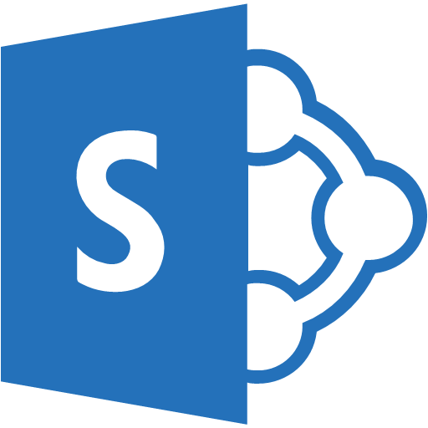

Simplifying Integration
Managed Middle Tier
API App[s]
On Premise Applications
Databases in Azure VMs
SharePoint Online
Cloud-Hosted Web App
SSO, Auth, Scale, etc.

Slide 21
Demo: Creating an API App

Slide 22
Logic Apps

Slide 23
Logic Apps for easy automation
Quickly integrate across services and APIs
Create workflows and logical flows for actions
No code designer for rapid creation
Dozens of pre-built templates to get started
Out of box support for popular SaaS and on-premises apps
Use with custom API apps of your own
Biztalk APIs for expert integration scenarios
LOGIC Apps
Automate SaaS and
on-premises systems
Notes:
Azure Logic Apps can help you integrate across services and devices quickly and simply.
Logic Apps allow developers to design workflows that start from a trigger and then execute a series of steps. Each step invokes an App Service API app whilst securely taking care of authentication and best practices, like checkpointing and durable execution.

Slide 24
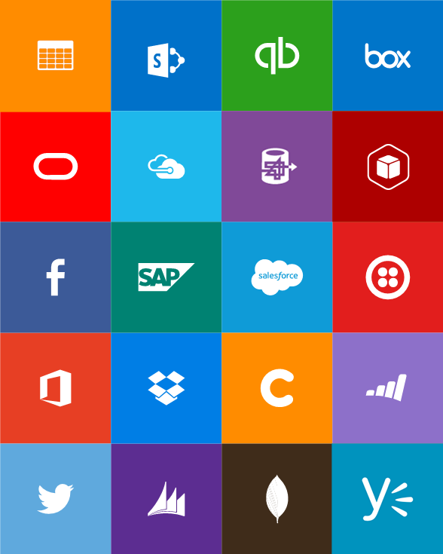
Built-in API Connectors
Connectors
Box
Chatter
Delay
Dropbox
Azure HD Insight
Marketo
Azure Media Services
OneDrive
SharePoint
SQL Server
Office 365
Oracle
QuickBooks
SalesForce
Sugar CRM
SAP
Azure Service Bus
Azure Storage
Timer / Recurrence
Twilio
Twitter
IBM DB2
Informix
Websphere MQ
Azure Web Jobs
Yammer
Dynamics CRM
Dynamics AX
Hybrid Connectivity
Protocols
BizTalk Services
HTTP, HTTPS
File
Flat File
FTP, SFTP
POP3/IMAP
SMTP
SOAP + WCF
Batching / Debatching
Validate
Extract (XPath)
Transform (+Mapper)
Convert (XML-JSON)
Convert (XML-FF)
X12
EDIFACT
AS2
TPMOM
Rules Engine

Slide 25
Demo: Creating an Logic App

Slide 26
Mobile Apps

Slide 27
Capabilities for Mobile apps:
Webjobs for long running tasks
CI with GitHub, BitBucket, VSTS
Auto-load balance, Autoscale, Geo DR
Virtual networking and hybrid connections
Site slots for staged deployments
Mobile Apps
Mobile services plus
a whole lot more

Slide 28








Azure Mobile Services
Storage
Authentication
Logic
Push
Scheduler
Notes:
Speaking Notes
Summarize earlier slide
Azure Mobile Services is a Backend-as-a-Service
Instead of you having to design, build, test, deploy, manage, and upgrade your whole backend, we do it for you
Features of Mobile Services
Storage – SQL DB
Authentication – built in support for social providers w/ ability to custom auth
Backend logic – data validation, logical flows, etc
Push Notifications – across all major mobile platforms
Scheduler – backend job processing

Slide 29
Structured Storage
Powered by SQL Database
Supports rich querying capabilities
Dynamic Schematization
Data management in:
Azure Portal
SQL Portal (Silverlight)
SQL Management Studio
REST API
Azure CLI Tools
SQL CLI
Microsoft Azure
Notes:
Speaking points
Mobile Service easily connects to SQL Database
SQL offers rich querying and indexing capabilities
Dynamic Schematization means you don’t have to be a DBA and manage schema
Data can be managed in:
Azure Portal (read and delete data)
SQL Portal (Silverlight)
SQL Management Studio (windows)
REST API (used by SDKs)
Azure CLI tools
SQL CLI (Node module)

Slide 30
Server Side Table Scripts
Node.js scripts
.NET Web API
backend in
Visual Studio
Passes through to SQL by default
MongoDB, Table Storage, SQL out of the box
Intercept CRUD requests to tables
Fully customizable
Notes:
Speaking points
Node backend generates Node scripts for each table action
Scripts intercept CRUD requests
Pass to SQL by default
Custom logic added here
Edit in portal (NODE)
.NET Backend creates Visual Studio project

Slide 31
Try App Service: Web Apps today
https://tryappservice.azure.com
Ask Questions:
Twitter:
Email
Public forum:

Slide 32
Q&A

Slide 33


Get started
Visit azure.microsoft.com

